Slide 1
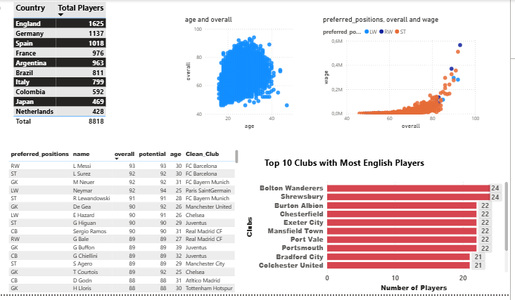
FIFA 2018 Player Performance & Positional Analytics 1

Slide 2
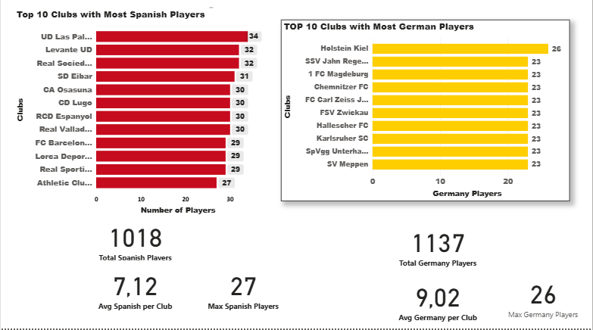
FIFA 2018 Player Performance & Positional Analytics 2

Slide 3
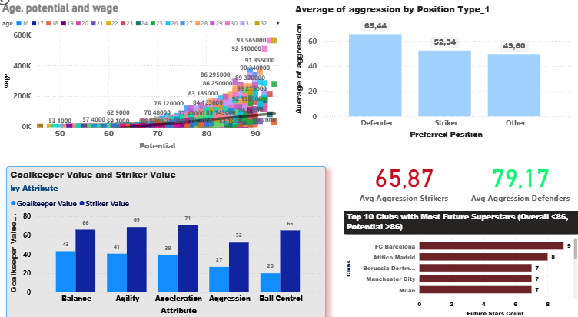
FIFA 2018 Player Performance & Positional Analytics 3

Slide 4
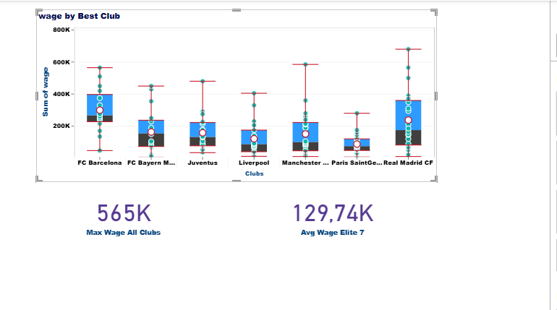
FIFA 2018 Player Performance & Positional Analytics 4

